Slide 1
Why Clojure?
Expressive & elegant
Approachable functional programming
Robust, easy-to-use concurrency
Leverage the JVM
Helpful, smart and active community
There's even Clojure CLR that is a complete port of Clojure up through 1.4

Slide 2
What is Clojure?
“Clojure is a dynamically and strongly typed programming language hosted on the Java Virtual Machine (JVM)...”
- Clojure Programming, pg. Xi
Dynamic
Functional
  Emphasis on immutability, but allow managed state
Supports Concurrency
Hosted on JVM, compiles to JVM bytecode
A new lisp (i.e. not Scheme, CL, etc.)

Slide 3
Review: What's a lisp?
Homoiconic (code-as-data)
Small language core
Functional
Parentheses everywhere
Prefix notation
Strong metaprogramming support

Slide 4
Features
Data types & abstractions
Syntax
Persistent data structures
Concurrent programming
JVM/Java interoperation
Metaprogramming

Slide 5
Data Types & Abstractions
Arbitrary-precision integers: 12345678987654
Doubles: 1.23; BigDecimals: 1.234M
Ratio/fraction literals: (/ 22 7) => 22/7
Strings: “foo”; Characters: \b \a \r
Symbols: banana potato; Keywords: :banana :potato
Booleans: true false; Null: nil
Regex: #”a*b”

Slide 6
Data Structures
• Lists - singly linked, grow at front
(1 2 3 4 5), (fred ethel lucy), (list 1 2 3)
• Vectors - indexed access, grow at end
[1 2 3 4 5], [fred ethel lucy]
• Maps - key/value associations
{:a 1, :b 2, :c 3}, {1 “ethel” 2 “fred”}
• Sets
#{fred ethel lucy}
• Everything Nests
(conj [1] [2 3]) => [1 [2 3]]
'({:b [4 5 6]} {:a [1 2 3]})

Slide 7
Concurrency
coordinated
uncoordinated
synchronous
Refs
Atoms
asynchronous
Agents

Slide 8
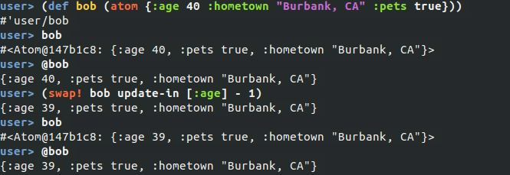
Atoms
“compare-and-set” semantics means this thread doesn't care what the value of `bob' is, only that the operation succeeds.

Slide 9
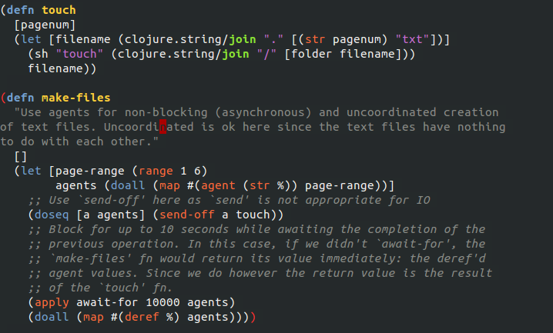
Agents

Slide 10
Refs
Using a ref ensures atomicity, consistency, and isolation
Clojure's refs makes these guarantees via software transactional memory (STM)

Slide 11
Java Interoperation
Clojure data types are implementations of corresponding data types, e.g. Clojure strings are Java Strings, fns implement Callable and Runnable, etc.
Core abstractions are Java interfaces
Clojure seq library works on Java Iterables, Strings and arrays.

Slide 12
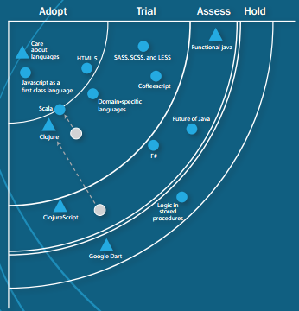



Is Clojure production-ready?
Notes:
Sources:
http://www.quora.com/Whos-using-Clojure-in-production
http://thoughtworks.fileburst.com/assets/thoughtworks-tech-radar-march-2012-us-color.pdf
Akamai uses Clojure in production thanks to their 2010 acquisition of Velocitude. Clojure is used in their “CAE mobil adaptation product”:
“real-time content transformation from a customer's desktop website and to present the data in a format suitable for a mobile phone, all while requiring minimal changes to the site by a customer. The main strength of our technique is that we directly consume their HTML and Javascript in the live system. The resulting application required a complex, many-layered architecture, including multiple DSL's, parsers, and DOM query tools”
Source: http://www.linkedin.com/in/straszheimjeffrey

Slide 13
Getting Started
Download Leiningen: https://github.com/technomancy/leiningen
Good Clojure support via emacs, vim and usual IDE suspects (Eclipse, IntelliJ, and VisualStudio... the latter for Clojure-CLR)
#clojure on freenode
Book: “Clojure Programming”

